Slide 1
Progress report
Speaker: Geng-Yun Tien
Advisor: Eric Y. Chuang
Date: 2023/11/22

Slide 2
Works
1
Repeat KRAS mutation prediction (attention-based model) from published paper
2
Repeat KRAS mutation prediction (transformer-based model) from published paper

Slide 3

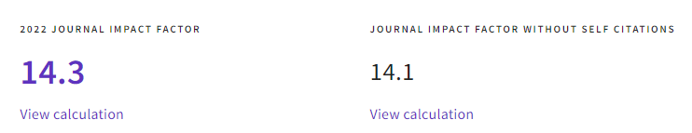
Literature review

Slide 4
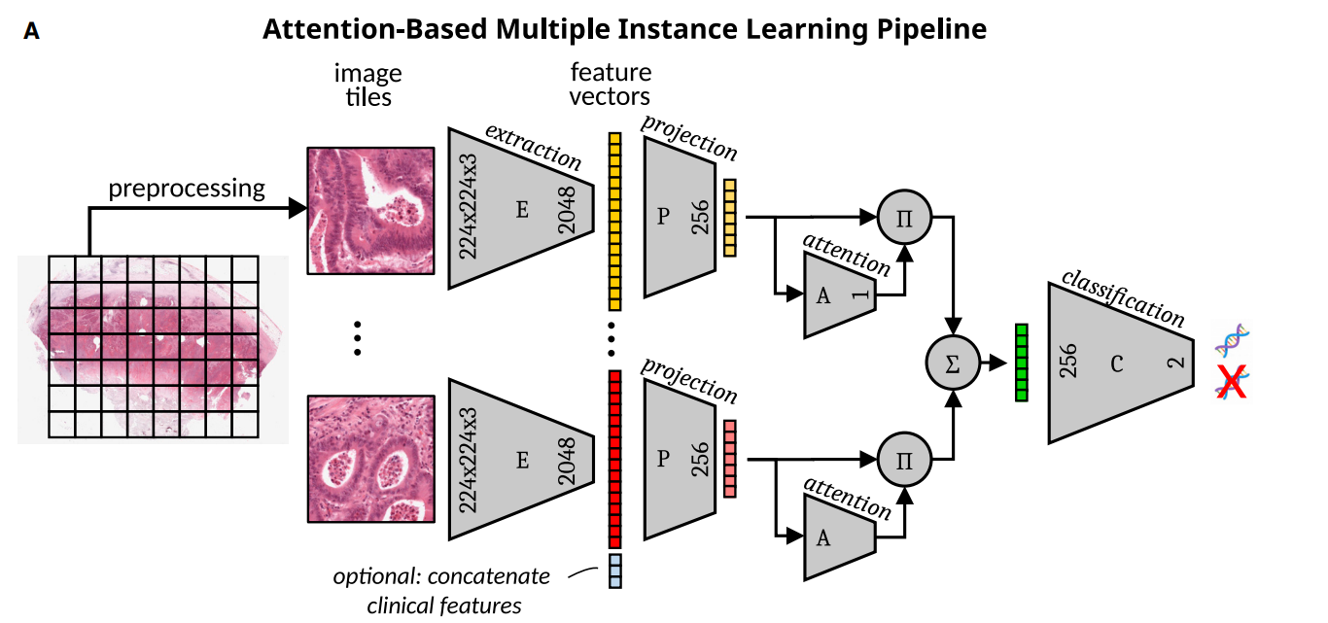
Proposed pipeline

Slide 5
Proposed pipeline
Remove the dimensional projector

Slide 6
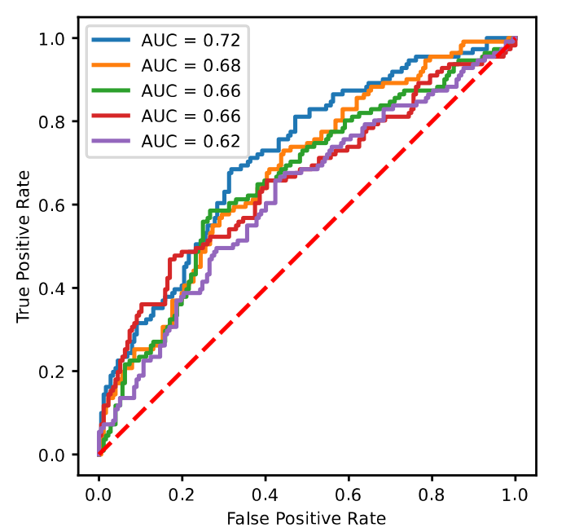
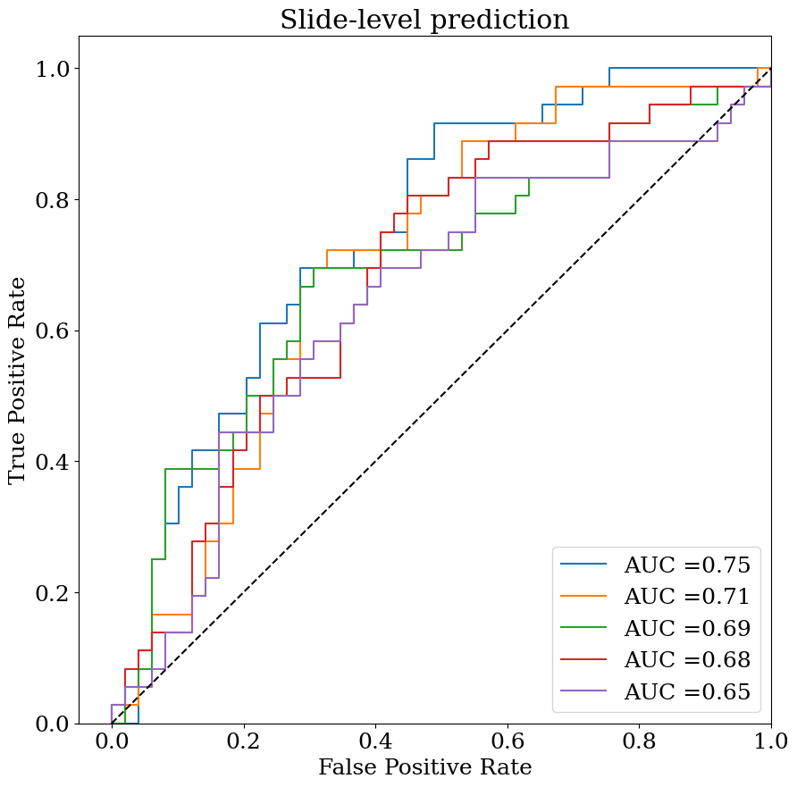
Results comparison in testing set
Literature result: AUC 0.67 ± 0.04
Our result: AUC 0.7 ± 0.04

Slide 7
Future work
1
Finish transformer-based model

